Slide 1
CUSTOMER RELATIONSHIP MANAGEMENT
CONCEPTS AND TECHNOLOGIES
Chapter 3
Planning and implementing CRM projects

Slide 2
Five major phases of a CRM project
Develop the CRM strategy
Build the CRM project foundations
Needs specification and partner selection
Project implementation
Performance evaluation

Slide 3
Phase 1: Develop the CRM strategy
Situation analysis
Commence CRM education
Develop the CRM vision
Set priorities
Establish goals and objectives
Identify people, process and technology requirements
Develop the business case

Slide 4
Phase 2: Build the CRM project foundations
Identify stakeholders
Establish governance structures
Identify change management needs
Identify project management needs
Identify critical success factors
Develop risk management plan

Slide 5
Phase 3: Needs specification and partner selection
Process engineering
Data review and gap analysis
Initial technology needs specification, and research alternative solutions
Write request for proposals (RFP)
Call for proposals
Revised technology needs identification
Assessment and partner selection

Slide 6
Phase 4: Project implementation
Refine project plan
Identify technology customisation needs
Prototype design, test, modify and roll out

Slide 7
Phase 5: Performance evaluation
Project outcomes
Business outcomes

Slide 8
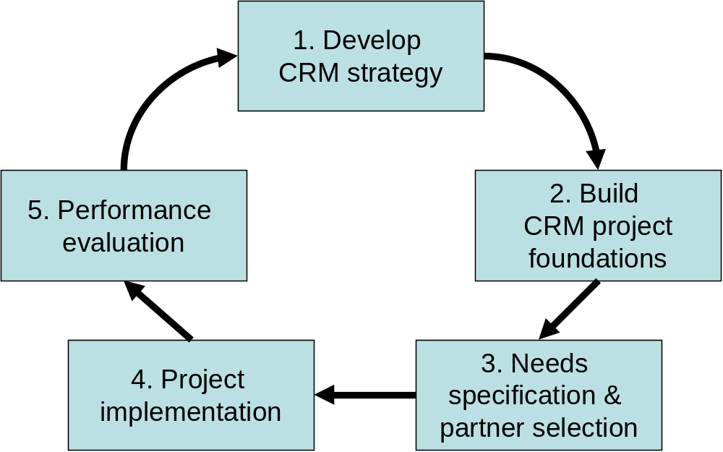
CRM project design and planning process

Slide 9
CRM strategy defined
CRM strategy is a high level plan of action that aligns people, processes and technology to achieve customer-related goals.

Slide 10
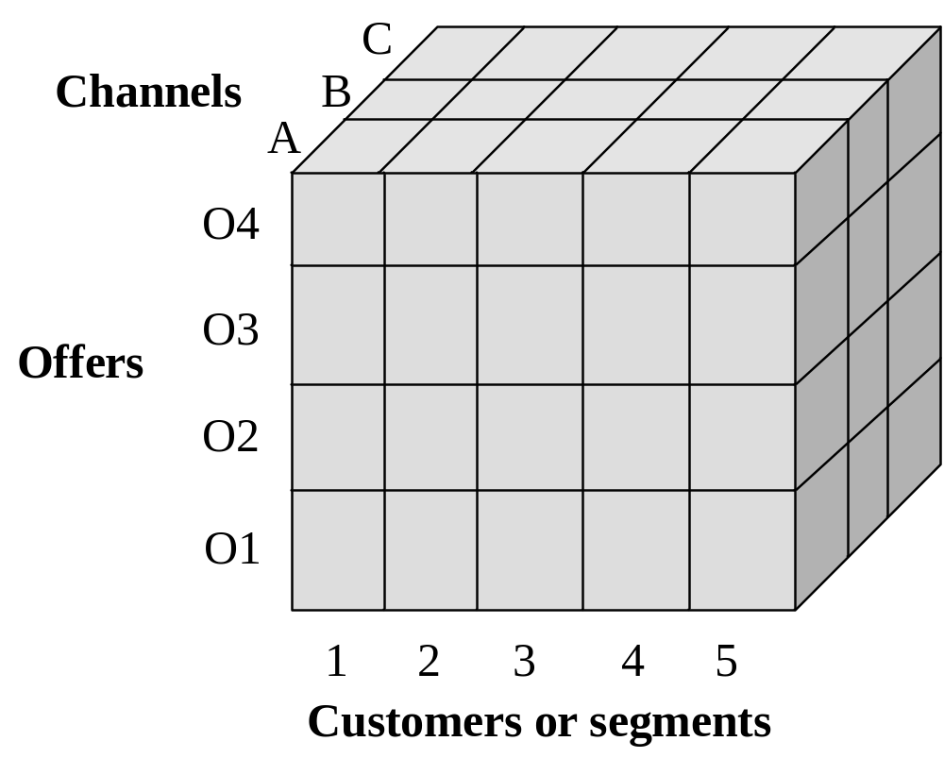
Situation analysis: the customer strategy cube

Slide 11
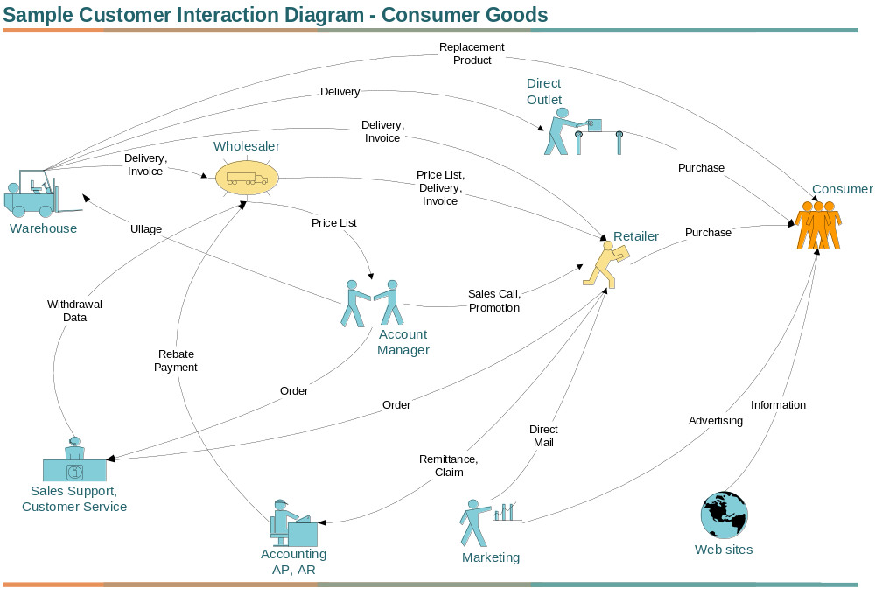
Customer interaction map

Slide 12
CRM education
The Institute of Direct Marketing
American Marketing Association
Websites and online communities
  www.customerthink.com
  www.mycustomer.com
  www.sharedinsights.com
  searchcrm.techtarget.com
  www.crm2day.com
  www.crmdirectory.com
  www.intelligententerprise.com

Slide 13
What is a CRM Vision?
A CRM vision is a high-level statement of how CRM will change a business as it relates to customers

Slide 14
CRM vision statements
We will work with our members in a trust-based relationship to represent their interests, and to satisfy their needs for high value, security, and peace of mind in motoring, travel, and home.
Nurturing relationships one cup at a time. Deliver a customer experience that consistently develops enthusiastically satisfied customers in every market in which we do business.
Build and maintain long-term relationships with valuable customers by creating personalized experiences across all touch-points and by anticipating customer needs and providing customized offers.
Nothing is more important than making every user successful.

Slide 15
Setting priorities
Clear priorities for action, normally focussed on cost reduction or enhanced customer experience, might fall out of the situation analysis, but more time and debate is often necessary.
Priority might be given to projects which
  produce quick wins or fast returns
  are low cost.
Longer-term priorities might prove more difficult to implement.

Slide 16
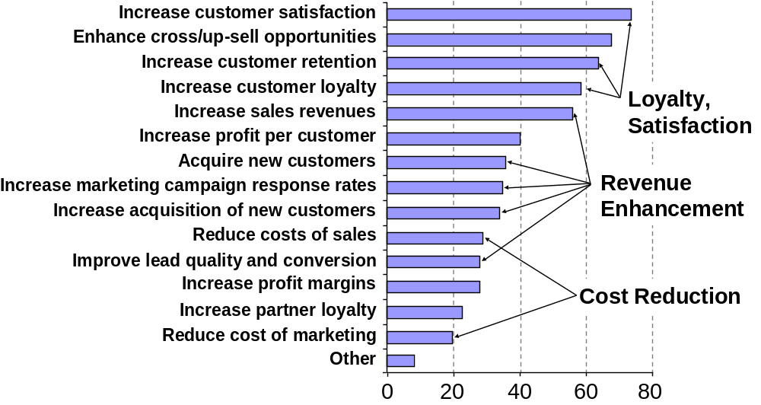
Strategic goals for CRM projects (Gartner)

Slide 17
Business case: revenues
CRM implementations can generate additional revenues in a number of ways:
  Conversion of more leads
  More cross-selling and up-selling
  More accurate product pricing
  Higher levels of customer satisfaction and retention
  Higher levels of word-of-mouth influence
  More leads and/or sales from marketing campaigns
  More sales from more effective selling processes

Slide 18
Business case: costs
CRM implementations can reduce costs in a number of ways:
  Improved lead generation and qualification
  Lower costs of customer acquisition
  More efficient account management
  Less waste in marketing campaigns
  Reduced customer service costs
  More efficient front-office processes

Slide 19
Understanding CRM project costs
  CRM software licence fees
  systems integration
  infrastructure costs, new desktop, laptop or handheld devices
  software configuration
  data modelling
  beta-testing
  helpdesk support
  change management
  project management
  process reengineering
  software upgrades
  training
  consultancy services
  opportunity costs

Slide 20
IT costs as a proportion of project costs
For a simple CRM project IT costs may represent one quarter of total project costs
For a complex CRM project IT costs may be as low as one tenth of total project costs

Slide 21
How to value the intangible business benefits of CRM?
Is it possible to value all CRM benefits? Consider these:
  development of a customer-centric way of doing business
  better customer experience
  improved responsiveness to changes in the market or competitive environments
  more information sharing between business silos
  improved customer service
  more harmonious relationships with customers
  the development of an information-based competitive advantage.

Slide 22
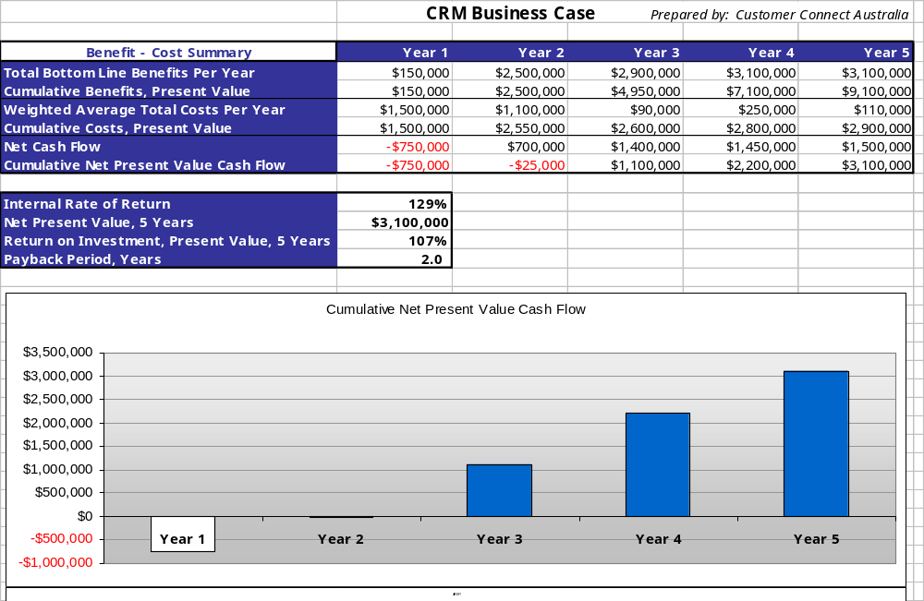
Business case summary data

Slide 23
Who are the stakeholders in CRM projects?
Stakeholders include any party that will be impacted by the adoption of CRM
  senior management
  users of any new system
  marketing staff
  sales people
  customer service agents
  channel partners
  customers
  IT specialists.

Slide 24
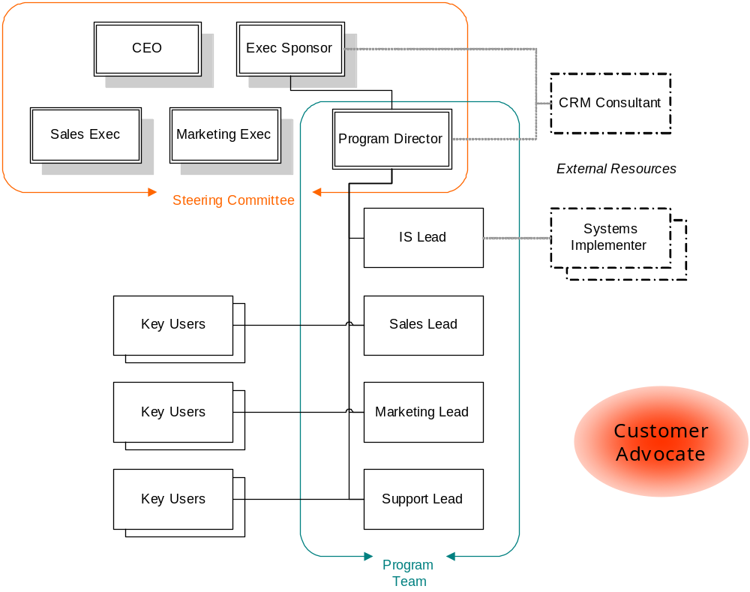
CRM project governance structure

Slide 25
The importance of change management
“Leadership teams that fail to plan for the human side of change often find themselves wondering why their best-laid plans go awry.”

Slide 26
Kotter’s 8-steps to managing change
Create a sense of urgency so that that people begin to feel “we must do something.”
Put together a guiding team to drive the change effort
Get the vision right, and build supporting strategies
Communicate for buy-in
Empower action by removing organizational barriers to change
Produce short-term wins to diffuse cynicism, pessimism and skepticism
Don’t let up, but keep driving change and promoting the vision
Make change stick by reshaping organizational culture

Slide 27
Organizational culture defined
Organizational culture is a pattern of shared values and beliefs that help individuals understand organizational functioning and thus provide them with the norms for behavior in the organization.
Essentially, organizational culture is understood to comprise widely shared and strongly held values. These values are reflected in patterns of individual and interpersonal behavior, including the behavior of the business leaders, and expressed in the norms, symbols, rituals and formal systems of the organization

Slide 28
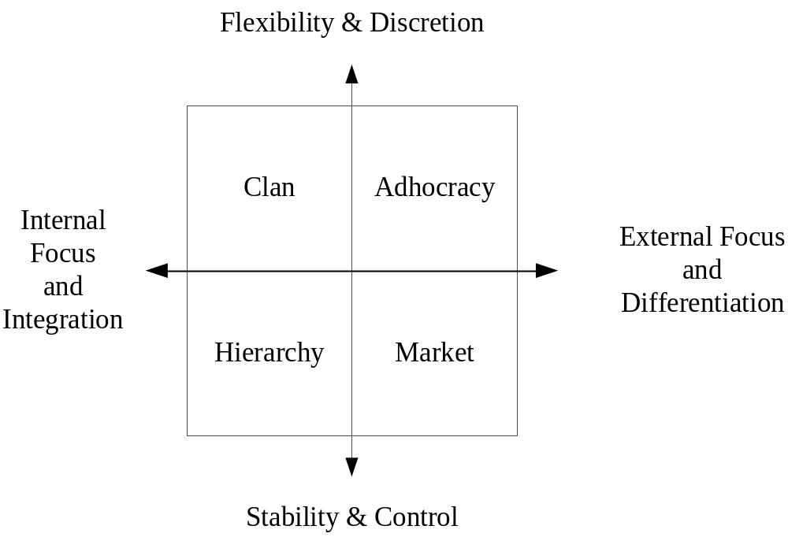
The Competing Values model of organizational culture

Slide 29
The buy-in matrix
Bystanders | Champions
Weak links | Loose cannons
Intellectual buy-in
No Yes
No Yes
Emotional buy-in

Slide 30
Identify project management needs
Role of CRM Program Director
Sets out steps of journey from situation analysis to achievement of CRM vision, goals and objectives
Tool kit: Gantt charts, Critical Path Analysis (CPA), Program Evaluation and Review Technique (PERT) or network diagrams .

Slide 31
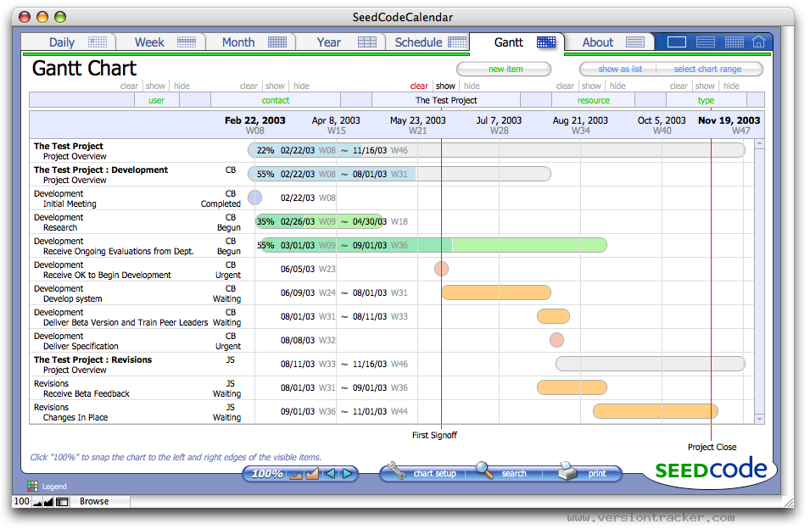
Gantt chart

Slide 32
Critical Success Factors
CSF’s are attributes and variables that can significantly impact business outcomes

Slide 33
CSF’s for CRM projects (more important in bold)
Critical success factor | People | Process | Technology
Senior management commitment | X
2. Creation of a multi-disciplinary team | X | X
3. Objectives definition | X
4. Interdepartmental integration | X | X
5. Communication of the CRM strategy to staff | X | X
6. Staff commitment | X
7. Customer information management |  |  | X
8. Customer service |  | X | X
9. Sales automation |  | X | X
10. Marketing automation |  | X | X
11. Support for operational management | X | X | X
12. Customer contact management | X |  | X
13. Information systems integration |  |  | X

Slide 34
Risk management plan
Gartner has identified a number of risks that threaten project success
  management that has little customer understanding or involvement
  rewards and incentives that are tied to old, non-customer objectives
  organizational culture that is not customer-focussed
  limited or no input from the customers
  thinking that technology is the solution
  lack of specifically designed, mutually reinforcing processes;
  poor-quality customer data and information
  little coordination between departmental initiatives and projects
  creation of the CRM team happens last, and the team lacks business staff
  no measures or monitoring of benefits and lack of testing

Slide 35
Business process defined
A business process is set of activities performed by people and/or technology in order to achieve a desired outcome.

Slide 36
Understanding business processes
Processes are ‘how things are done’
Processes can be classified as
  Vertical and horizontal
  Front-office and back-office
  Primary and secondary
CRM processes include all customer-facing (front-office) processes within sales, marketing and service functions

Slide 37
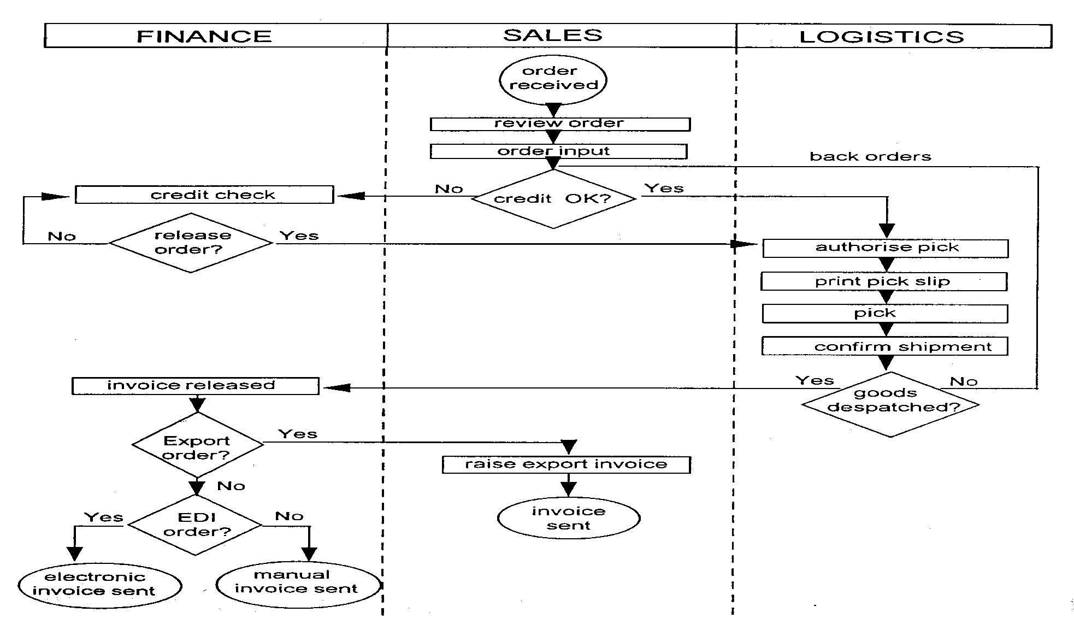
Order fulfilment process

Slide 38
Campaign management process
Customer phones in
Check scores
Buy product
No interest
Offer product to high scores
Open account on phone
2
Send application form
7
42
Out bound phone follow-up
7
Check account balance
Mail follow-up
Do nothing
(numbers are days)

Slide 39
Back office processes that support CRM
Procurement must buy the right type and quality of input goods and services
HR needs to recruit the right people to fill customer-facing roles
Operations needs to manufacture to the specifications and time requirements of customers
Finance must trace costs to customers to compute customer profitability

Slide 40
Questions about CRM processes
What are the important processes from a CRM point of view?
How is the present process designed?
What does it contribute to the achievement of CRM objectives?
What do its customers, internal and/or external, receive from and think about the process?
What process performance measures are in place?
  Cost, time, accuracy, satisfaction
Can the process and its outcomes be improved?

Slide 41
Evaluating processes
 | Process rating
Best practice (superiority) | The process is substantially defect-free and contributes to CRM performance. Process is superior to comparable competitors and other benchmarks
Parity | A good process which largely contributes to CRM performance
Stability | An average process which meets expectations with no major problems but which presents opportunities for improvement
Recoverability | The process has identified weaknesses which are being addressed
Criticality | An ineffective and/or inefficient process in need of immediate remedial attention

Slide 42
Data review and gap analysis
Customer-related data is used for strategic, operational, analytical and collaborative CRM purposes
Identify the information needed
Identify the information available
Identify the gap
Consider data quality issues

Slide 43
Initial technology needs specification and research alternative solutions
Identify applications and functionality that meets business case requirements
  Visit vendor websites
  Join online communities and learn from members
  Visit online CRM exhibitions
  Read case studies
  Join benchmarking group
Consider build, buy or rent decision
  Consider total cost of ownership
Most users opt for an on-premise (installed) CRM system or a hosted (online) system.

Slide 44
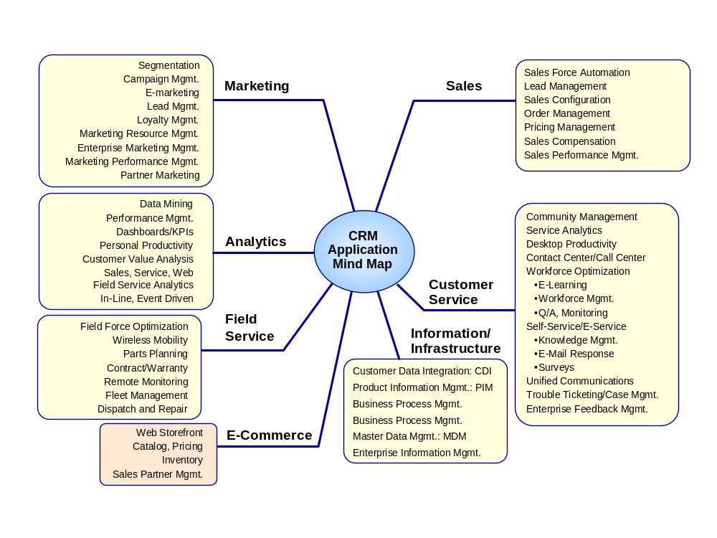

Slide 45
Benefits claimed for hosted solutions
Costs are fixed and known.
  Companies pay a per-seat monthly fee. If you have 50 users, and the monthly fee is $100 per user, you can expect annual user fees of $60,000.
Upgrades are performed by the vendor away from the users’ premises.
On-premise implementations, in contrast, can impose significant burdens on in-house IT staff and budgets.
  There can be upfront investments in IT hardware and infrastructure, software purchase and customization, and training. Implementation costs can be significant.
User support and software upgrade costs are additional to initial software licence costs.
Essentially, the hosted model converts capital expenditure and fixed costs into variable costs.

Slide 46
Comparing first-year costs: on-premise vs. hosted CRM
Cost item | On-premise CRM | Hosted CRM
Number of users | 500 | 500
Application licence/subscription | $1,250,000 | $750,000
Implementation and customization | $6,250,000 | $187,000
Training | $150,000 | $75,000
IT infrastructure/hardware | $500,000 | $0
IT personnel | $500,000 | $0
Support/upgrade costs | $225,000 | $0
Year one expenditure | $8,875,000 | $1,012,500
Sources: Triple Tree; Software & Information Industry Association (SIAA); salesforce.com; Yankee Group. Table originally appeared in eMarketer 2005.

Slide 47
Comparing lap-top and PDA devices
Attribute | Laptop | PDA
Content | Full | Narrow
Size | XXXX | X
Portability | Moderate | High
Start time | Moderate | Fast
Speed of input | Fast | Slow
Dialogue barrier | Yes | No
Stickiness | Moderate | High
Walk and use | No | Yes
Presentations | Excellent | Good
Replacement cost | High | Moderate
Synchronisation | Good | Excellent

Slide 48
Contents of RFP 1
Instructions to respondents
Company background
The CRM vision and strategy
Strategic, operational, analytical and collaborative CRM requirements
Process issues:
  Customer interaction mapping
  Process re-engineering

Slide 49
Contents of RFP 2
Technology issues:
  Delivery model – SaaS, on-premise, blended
  Functionality required – sales, marketing and service
  Management reports required
  Hardware requirements
  Architectural issues
  Systems integration issues
  Customization issues
  Upgrades and service requirements

Slide 50
Contents of RFP 3
People issues:
  Project management services
  Change management services
  Management and staff training
Costing issues – TCO targets
Implementation issues – pilot, training, support, roll-out, time-line
Contractual issues
Criteria for assessing proposals
Time-line for responding to proposals

Slide 51
Partner selection process
Assessment is made easier if you have a structured RFP and scoring system.
There are two types of scoring system – unweighted and weighted.
  An unweighted system simply treats each assessment variable as equally important.
  A weighted system acknowledges that some variables are more important than others. These are accorded more significance in the scoring process.

Slide 52
Project implementation
Refine project plan
  Consider needs and availability of partner
Identify technology customisation needs
  Out-of-the-box rarely fits perfectly
Prototype design, test, modify and roll out
  Risk reduction
  Refinement
  Pilot on a small group of users or customers

Slide 53
Performance evaluation
Project outcomes
  Was the project has been delivered on time and to budget.
Business outcomes
  Have business goals and specific CRM objectives been achieved?
  Consider time-frame for CRM objectives

